Slide 1

Wrike
Website: www.wrike.com
History:
The company was founded in 2006 by entrepreneur Andrew Filev, and currently has offices in San Jose, San Diego, and Dublin, Ireland.
Mobile support:
iOS
Android
Logo

Slide 2
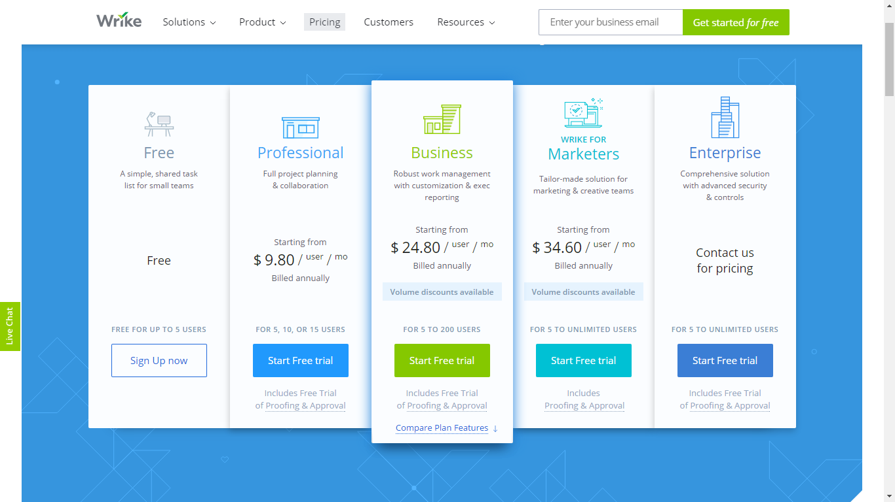
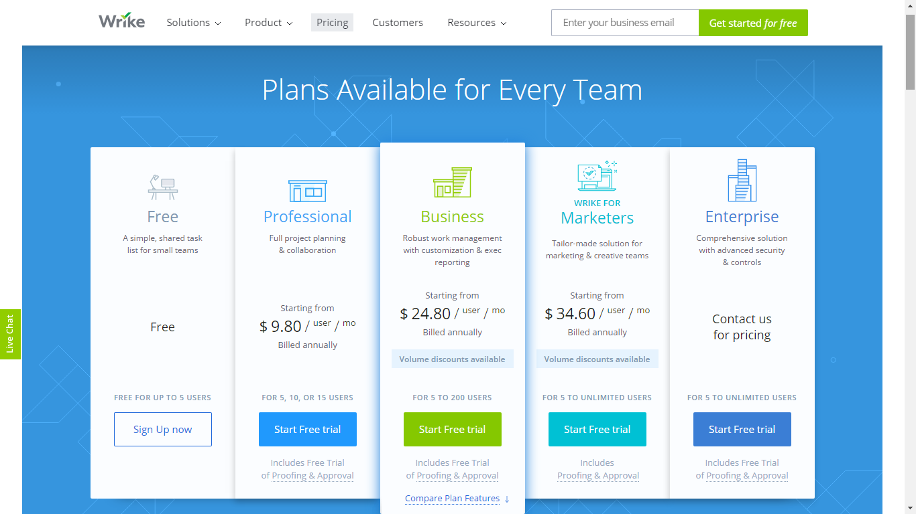
Wrike

Slide 3
Wrike
Some features:
Create Projects
Request Form & Automation
Live Editing & File Management
Timeline (Gantt-Chart)
Resource Management
Templates
Time & Budget Tracking
Personal Dashboard
Communication
Live activity stream
Create user groups
Email & Calendar Synchronization

Slide 4
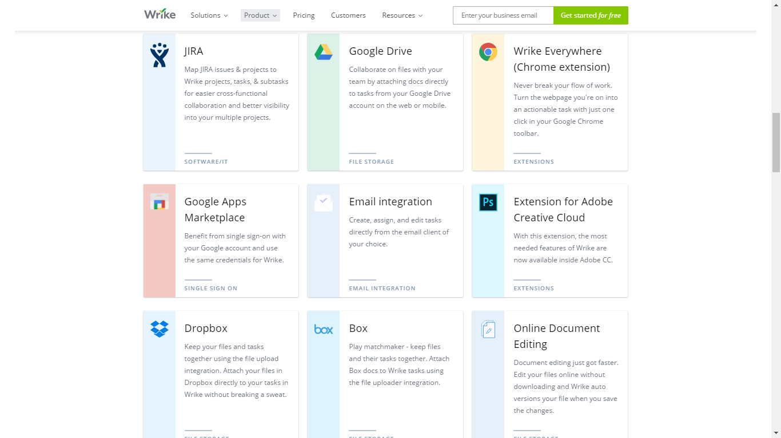

Slide 5
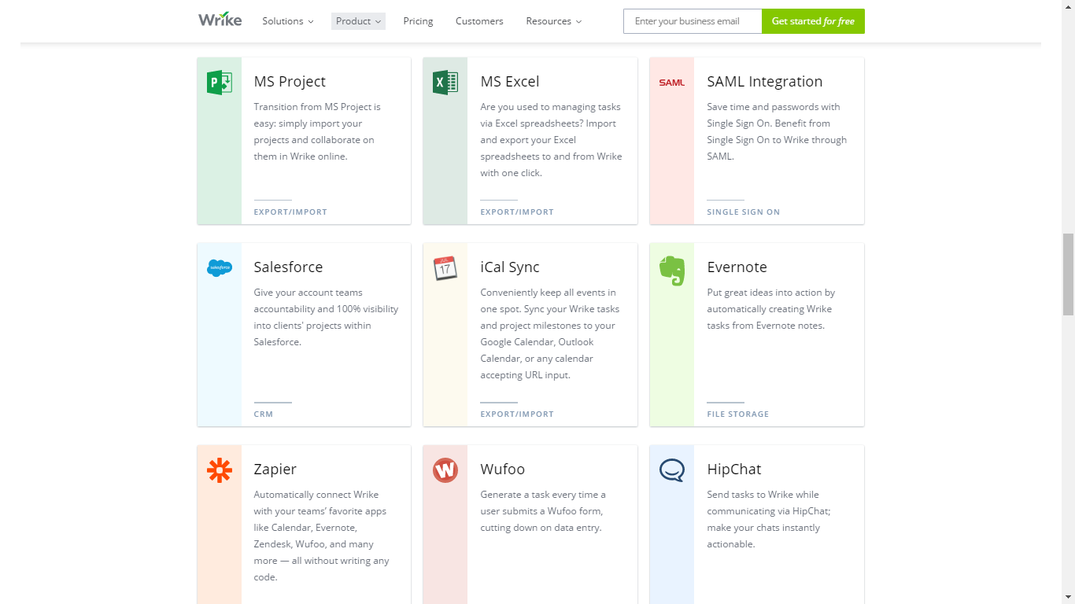

Slide 6
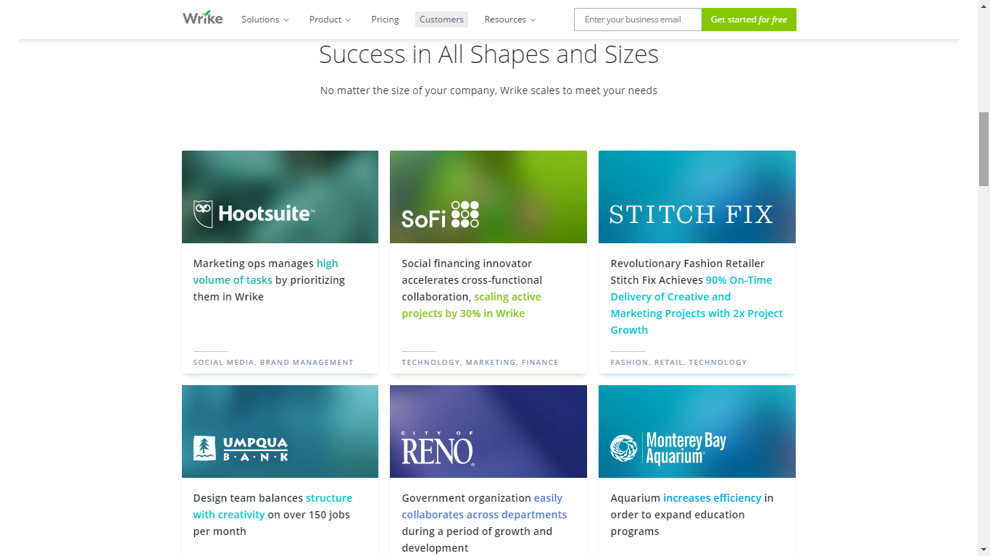

Slide 7
Wrike
Awards:
2009 - Red Herring's Top 100 Global Company Award
2015 - Listed in by Deloitte’s 2015 Technology Fast 500TM Ranking
2015 - Named one of the "Best Places to Work" by San Francisco Business Times/Silicon Valley Business Journal
Group B comment:

